Slide 1
JavaScript Overview for Web Development
Intro to JavaScript
Notes:
Hello everyone and welcome to this lesson, where we are going to do a quick overview of JavaScript

Slide 2
Front-end web development
HTML
Structure and content
CSS
Styling and layout
JavaScript
Dynamic interactivity
Notes:
The 3 core components of modern front end web development is HTML, CSS and JavaScript. HTML provides structure and content of the web page, while CSS adds on styling and layout so that the content is presented in a visually attractive manner. Finally, JavaScript allows the web page content to change dynamically in response to user interaction with it. For .e.g actions such as. the user moving the mouse over certain web content or clicking on specific elements on the page will cause certain elements to change in size, move, appear or disappear. Typically, you use JavaScript with HTML and CSS to enhance a web page’s functionality, such as validating forms, creating interactive maps, and displaying animated charts.

Slide 3
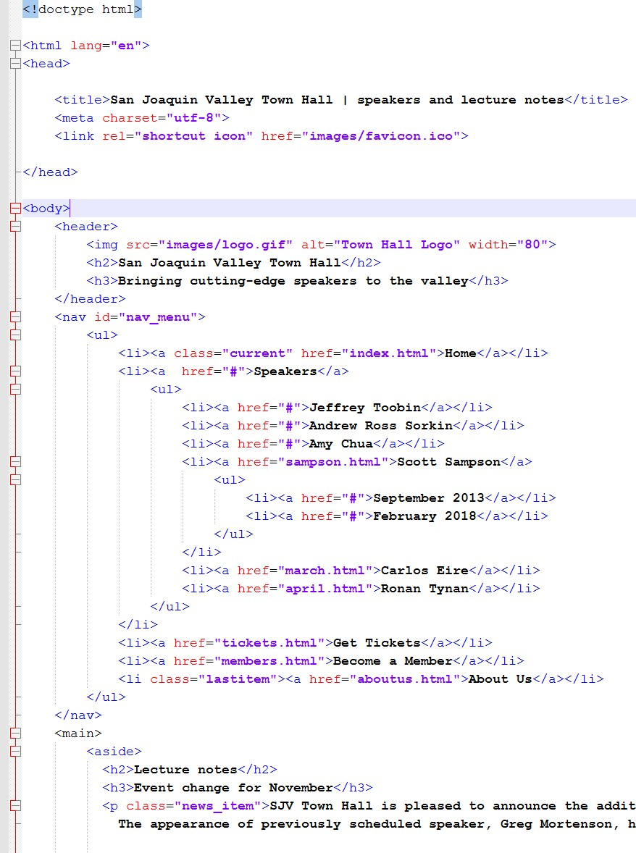
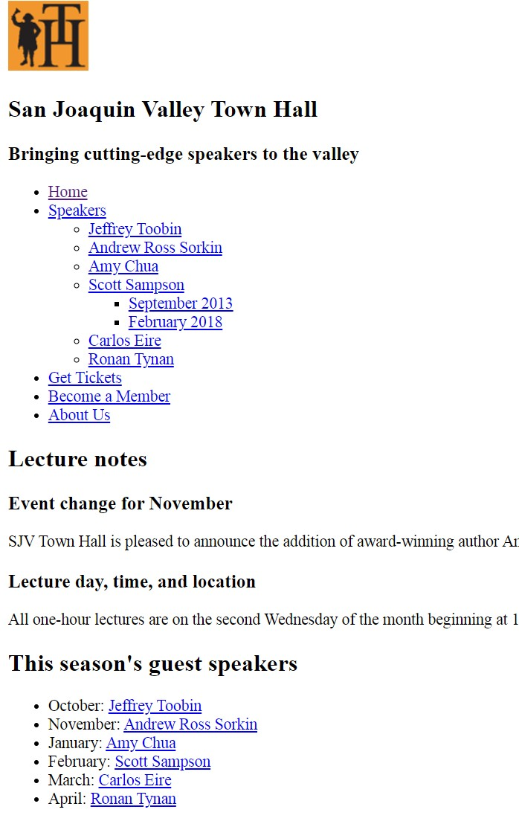
HTML
Notes:
Here is an example of a web page constructed with only HTML. As you can see there is some basic structure: (bulleted lists) and headings as well as the actual content. However, everything appears pretty uniform across the page and is laid out from top to bottom.

Slide 4
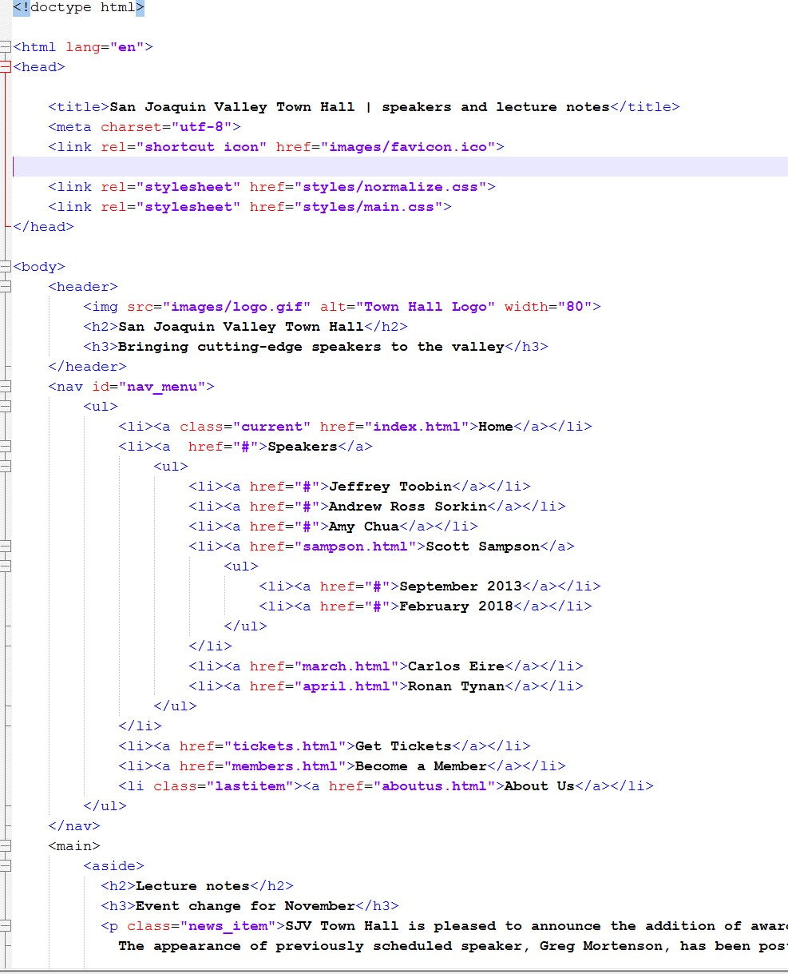
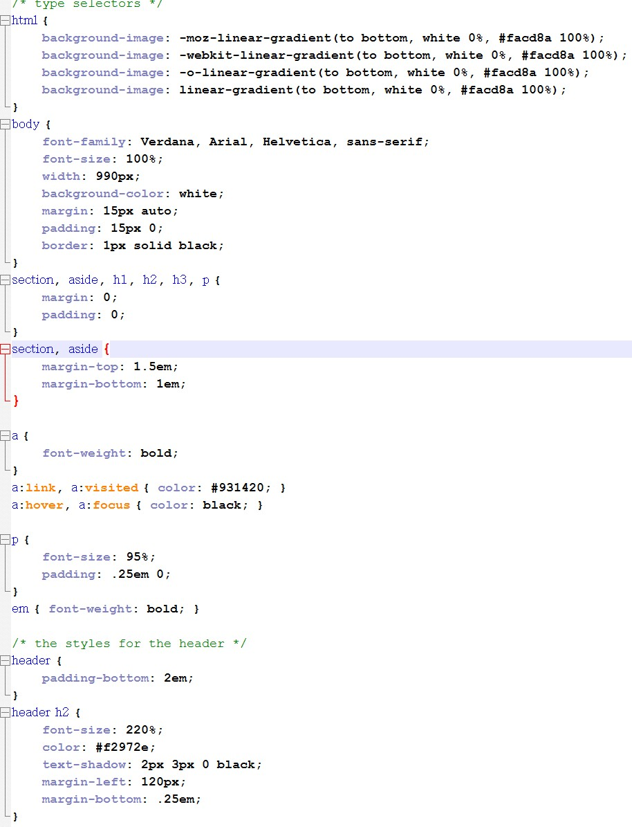
HTML
+
CSS
Notes:
Now we a link in a CSS stylesheet to the HTML, with selectors to target the various HTML elements and style them appropriately, for e.g. changing font size, color and type, setting location and spacing between elements, special effects such as shadows and so on.

Slide 5
Common JS functionality
Modify the content of a web page by adding or removing elements.
Change the style and position of the elements on a web page.
Monitor events like mouse click, hover, etc. and react to them
Perform and control transitions and animations.
Create alert pop-ups to display info or warning messages to the user.
Perform general processing operations based on user inputs and display the results.
Validate user entry in a form before submitting it to a server
Notes:
Some of the most common tasks that JavaScript is typically used for include
modifying the content of a web page by adding or removing elements.
Change the style and position of the elements on a web page.
Monitor events like mouse click, hover, etc. and react to them
Perform and control transitions and animations.
Create alert pop-ups to display info or warning messages to the user.
Perform general processing operations based on user inputs and display the results.
Validate user entry in a form before submitting it to a server
Note that this is not an exhaustive list as JavaScript can be used for anything purpose that requires dynamic interactivity on the web page, for e.g. browser-based games such as massively multiplayer online role-playing game or MMORPGs.

Slide 6
Intro to JavaScript
JavaScript (JS) is a lightweight, interpreted or just-in-time compiled programming language
Most well known scripting language for web pages
All browsers have a JavaScript engine that executes JavaScript code
Also used in server-side run time environments (e.g. Node.js)
Notes:
JavaScript (JS) is a lightweight programming language that can either be interpreted or compiled before executed inside a browser. Early versions of JS were interpreted but the latest versions of the JavaScript engine in modern browsers such as Chrome, Edge, Firefox and Safari all use just-in-time or JIT compilation. This essentially combines the benefits of both normal compilation and interpreation. In compilation, the entire source code was translated into native binary code prior to execution. In interpretation,each program statement was read and executed one at a time. JIT compilation improves performance of interpreted programs by dynamically deciding which portions of the source code to compile into native binary code during execution. Doing compilation at run time allows better optimization of the generated native binary code.
JavaScript is most well known as the primary (and in fact the only) scripting language for web pages at this point in time. All modern browsers have a JavaScript engine that performs JIT compilation and execution of JavaScript code. However, JavaScript has found adoption in a multitude of environment and is also widely used in server-side run time environments. For e.g Node.js (e.g. Node.js) is an open-source and cross-platform JavaScript runtime environment that is used in the development of popular backend web frameworks such as Express.js and Next.js

Slide 7
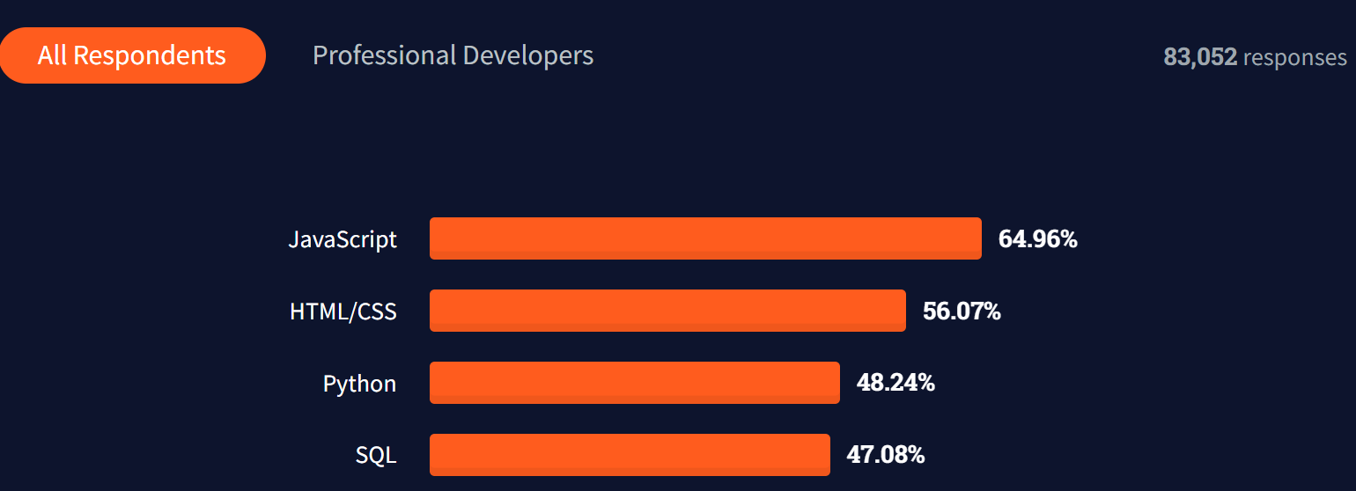
Stack overflow Survey 2023
Notes:
JavaScript currently ranks as the most widely used language on the latest StackOverflow developer survey, making it almost a prereqquisite skill for any software developer to have on their job resume. Notice as well that HTML/CSS ranks second.

Slide 8
JavaScript features
Dynamic typing
Single threaded
Uses prototype-inheritance
as opposed to pure OOP (Java, C#)
supports functional programming style
where functions are first class citizens
Notes:
Some of the key features of JavaScript include
Dynamic typing - You can assign values of different types to the same variable, for e.g. strings, numbers and even boolean values. This gives it additional flexibility in many situations compared to languages that use static typing such Java, C# or C++ although it also makes it easier to inadvertently introduce bugs into the application
Single threaded - means that JavaScript program cannot handle multiple concurrent streams of execution, so it will need to incorporate specific features to handle non-blocking asynchronous I/O operation as we will see later in the lab session.
Uses Prototypal inheritance - On the surface, this is conceptually similar to inheritance used in pure OOP such as Java, C# and C++, but it is very different in implementation and usage, as we shall see in the labs later on
supports functional programming style - A functional programming style involve using functions as first class citizens. This means that you can store functions in variables, pass them to other functions as arguments, and return them from other functions as values. This leads to some pretty interesting ways of writing code, as we shall see in the labs later on.

Slide 9
JavaScript versions
Created by Brendan Eich at Netscape in 1995
Adopted as a standard by ECMA in 1997 - ECMA262 standard for ECMAScript
2 main revisions (2009, 2015)
ES6 (ECMA2015) represents the most significant update to the language
Yearly additions since then (ECMA2016 – 2021)
Notes:
In 1995, JavaScript was created by a Netscape developer named Brendan Eich. It underwent several name changes: from the initial name of Mocha to LiveScript and then finally to JavaScript. The final name change was due to Netscape wanting to leverage on Java's fame at that point of time, although it is importat to stress that JavaScript is a very different language from Java as you will soon see in the upcoming labs.
In 1997, JavaScript 1.1 was submitted to the European Computer Manufacturers Association (ECMA) as a proposal. A technical committee was assigned to standardize the language to make it a general-purpose, cross-platform, and vendor-neutral scripting language. The standard for this was known as ECMA-262, and JavaScript is officially known as ECMAScript (often pronounced Ek-ma-script).
The first significant revision of the language was ES5 which was in 2009, and the second and what is considered the latest major update to the language is ES6 or ECMA2015. Although there have been yearly updates since then up to 2021, ES6 is considered by many developers as “Modern JavaScript” because of all the major additions that incorporated many new features that are widely used in all JavaScript programs created today. They allow the developer to write more concise and precise code, as we will see later in the upcoming labs.
ES6 is fully supported by the latest version of all major browsers (Chrome, Edge, Firefox and so on). The later versions have varying degrees of support for the newly introduced features, so to ensure that your JavaScript program can run on any browser, it is best to confine the feature set that you use to ES6 or ECMA2015

Slide 10
JavaScript components
Core JavaScript
without any libraries – vanilla JavaScript
Document Object Model (DOM)
API for interacting with HTML elements on web pages
Browser Object Model (BOM)
API for interacting with the web browser
Notes:
JavaScript consists of three main parts
The core portion of the JavaScript language which is common across all environments, whether running in a browser or on a server-side run time environment such as Node.js. Because this component does not have any additional libraries or modules on top of it, you will often see the term vanilla JavaScript being used to refer to it to distinguish it from more full blown and feature enhanced libraries such as Jquery or even frameworks such as React or Angular
The Document Object Model (DOM) is a API specific for JavaScript program executing in a browser that allows the program to interact and manipulate HTML elements on the web page
The Browser Object Model (BOM) is a API specific for JavaScript program executing in a browser that allows controlling specific aspects of the browser functionality, for e.g. displaying a dialog box or modal dialog or managing the browser's history stack.
Both the DOM and BOM is provided by the browser itself, while the core JavaScript code runs in the JavaScript engine.

Slide 11
Document Object Model (DOM)
language-independent interface
models a HTML document as an upside down tree
each node of the tree is an object representing a part of the document.
Browsers represent HTML as a DOM
Each HTML element becomes a node or object of the tree
Notes:
So how did a Javascript program running in the browser do all the magic that we saw just now ?
Well, its basically through manipulation of the DOM tree
So the Document Object Model (DOM) is a cross-platform and language-independent interface that treats a HTML document as a tree structure wherein each node of the tree is an object representing a part of the document. Browsers represent a HTML page internally in memory as a DOM tree, where each HTML tag becomes a node or object of the tree.

Slide 12

Document object model (DOM)
Notes:
So when the browser loads a HTML file along with is corresponding CSS stylesheet, it represents it internally in memory as a DOM tree like this. Each node or object in the tree corresponds to a specific HTML element in the original HTML document.

Slide 13
Document object model (DOM)
Javascript program
Notes:
The DOM tree is subsequently exposed as an API to a Javascript program which can then call methods or access properties on any of these objects in order to:

Slide 14
Document object model (DOM)
Javascript program
Modify any of the DOM elements and properties
React to all existing user events
Notes:
add, change, and remove any of the DOM objects and properties
react to all the existing user events, such as mouse clicks and hover events, text typed and so on

Slide 15
Document object model (DOM)
Javascript program
Unchanged on hard disk
Dynamically changing in memory
Notes:
An important point to note here is that once the browser has created an internal DOM to represent the HTML file when it is initially loaded, the view shown in the browser window is based on this in-memory DOM, and not the original HTML file. So any dynamic changes made to the DOM by a Javascript program are immediately shown in the browser window as in the memory game that I demonstrated earlier, while the original HTML remains unchanged on local storage.
{Action: show memory game video demo in upper right hand corner]

Slide 16
JavaScript engine
Core software component in the browser that executes JavaScript code
Early engines were pure interpreters; modern-day engines use just-in-time compilation for optimal performance
Runs in tandem with the rendering engine of the browser via the DOM.
Some common JavaScript engines
V8 for Chrome (Chromium), also used for Node.js
Spidermonkey for Firefox
JavaScriptCore for Safari
Chakra for IE (but Edge uses Chromium now)
Notes:
As mentioned earlier, the JavaScript engine is the Core software component in the browser that executes JavaScript code.
Early engines were pure interpreters; modern-day engines use just-in-time compilation for optimal performance. It runs in tandem with the rendering engine of the browser via the DOM.
Some common JavaScript engines include
V8 for Chrome, also used for Node.js. Chromium is the open source browser project headed by Google which is the basis for the Chrome browser.
Spidermonkey for Firefox used by Mozilla
JavaScriptCore for Safari used by Apple
Chakra for IE (but Edge uses Chromium now)

Slide 17
Ways to execute JavaScript
Referencing JavaScript program in HTML document (most common)
Written directly (vanilla) or produced using a JavaScript library / framework
Performs DOM manipulation and reacting to user events
Running JavaScript program directly in Node.js
Running JavaScript in console tab of DevTools
Using online JavaScript playground
Notes:
There are a multitude of ways to execute a JavaScript program.
We can directly reference a separate JavaScript program from a HTML document using the script tag, or directly embed the JavaScript code between a pair of script tags. Then opening the HTML document in a browser will automatically load and execute the referenced JavaScript code.
We can install Node.js on our system and run the JavaScript program directly using Node.
We can type JavaScript statements directly in the console tab of Chrome DevTools, or any other DevTools equivalent of other major browsers such as Edge or Firefox. This console tab is essentially a REPL or Read Evaluate Print Loop shell that is conceptually similar to the REPL shell in Python or later versions of Java.
We can use online JavaScript playground, where we can type JavaSCript code directly into a browser app where it will be executed.
If we are working using a JavaSCript framework such as React, Angular, Vue, Express.js or Next.js, then the framework itself will already provide its own customized tools to compile and run the JavaScript application.

Slide 18
Creating a JavaScript program to manipulate the browser DOM
Vanilla (pure) JavaScript
Libraries
Frameworks

Slide 19
Libraries
Contain functions, methods and objects that simplify DOM manipulation
Allows easier construction of application vs using vanilla JavaScript

Slide 20
Popular libraries
JQuery
one of the earliest and most popular lightweight libraries simplifies DOM manipulation, event handling and Ajax
React
Created by Meta / Facebook for building UIs, popular for social media development
D3.js
Used for performing data visualization (graphs, charts, tables) for data analytics / machine learning applications

Slide 21
Frameworks
Structure or template for providing foundation for creating full blown web applications
Provides a structured way to develop app (vs free form using libraries)
Provides many in-built useful functionalities to minimize development time
Advantages
Simpler testing and debugging
Clean and easily maintainable code
Allows dev to focus on core business logic of app
Notes:
Frameworks are an additional custom extension to the core JavaScript language which provides a foundation for creating specific types of applications, particularly web applications. This eliminates the need to code the application from scratch because a lot of standard functionality is already pre-built into the foundation template. It also provides many in-built useful functionalities to minimize development time resulting in cleaner and more easily maintained code. A significant portion of JavaScript code development today is done using frameworks.

Slide 22
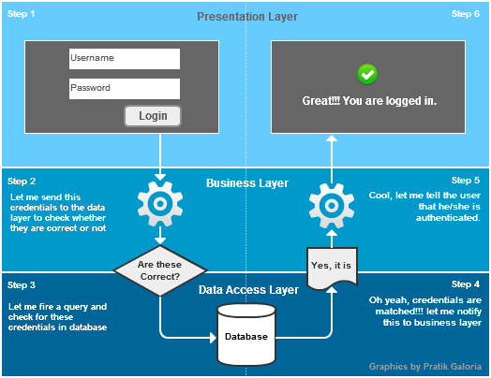
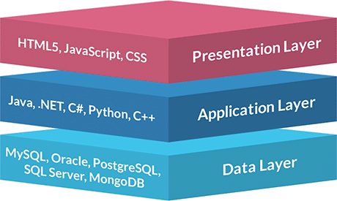
3-tier web application
Notes:
There are many architectural styles possible for a web-application, but the most commonly used one is the 3-tier model.

Slide 23
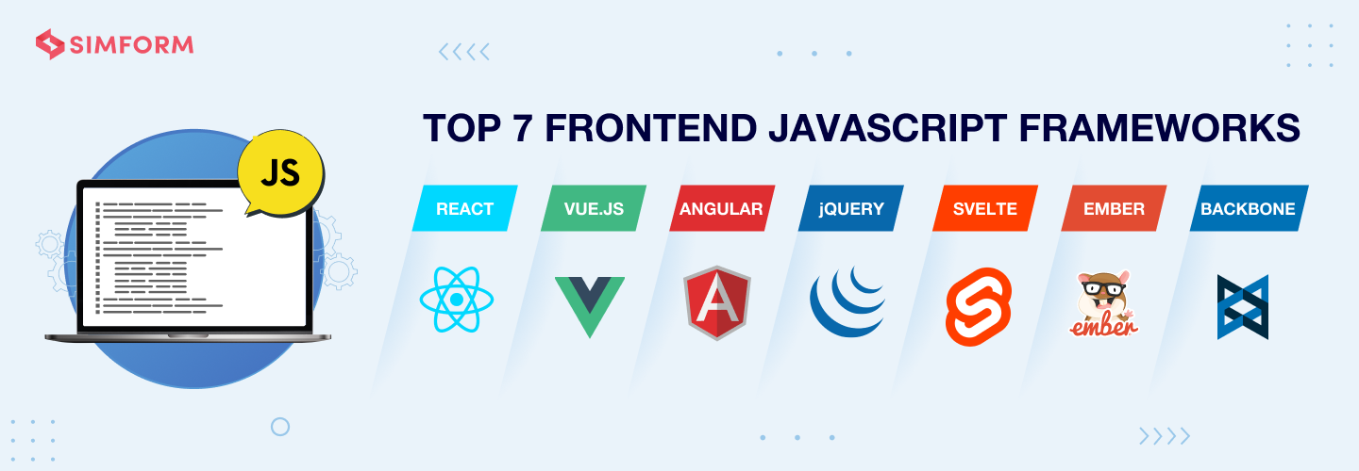

Slide 24
JavaScript front-end frameworks
Angular
Developed by Google, popular for implementing a Single Page Application (SPA) and also Progressive Web Apps (PWA) and desktop apps
Based on Typescript, a superset of ES6
Fast code generation and use of templating approach
Notes:
Front end frameworks are for building JavaScript programs that run in the browser itself. Technically we would call this client side scripting, as we will see later. The two most popular ones are Angular and React.
Angular was developed by Google and is popular for implementing a SPA and also Progressive Web Apps (PWA) and desktop apps. It is based on TypeScript, which is an extension on ES6. It provides fast code generation and use of templating approach
React was developed by Facebook uses the concept of a virtual DOM to render changes. It also uses a special form of markup that is different from HTML that is known as JSX.

Slide 25
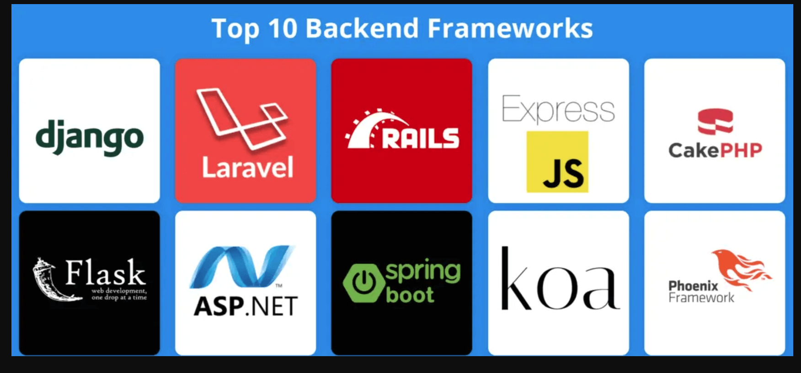

Slide 26
JavaScript back-end frameworks
Node.js
Cross platform and based on event drive architecture to perform asynchronous I/O
Builds on V8 engine of Chrome
Express.js
Primarily works with Angular.js as front-end and as default server framework for Node.js
Lightweight and large number of plugins
Notes:
Back-end frameworks are used for building web applications that run server side. Node.js is the most well known among these: it is cross platform and based on an event drive architecture to perform asynchronous I/O. It builds on the V8 engine of Chrome
Express.js is a popular choice to be coupled with Angular as the front-end framework and is the default server framework for Node.js.

Slide 27
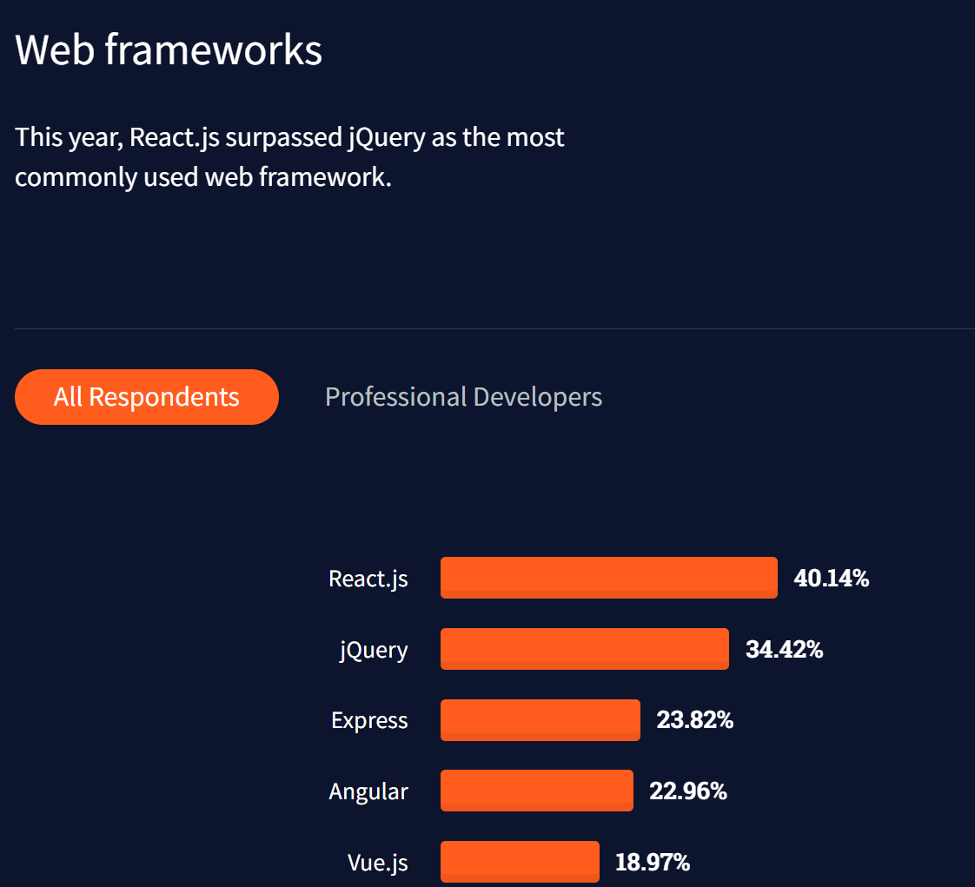
Notes:
We can also see that the top 5 web frameworks in use by developers globally are all JavaScript based frameworks, with all of them with the exception of Express being front end frameworks.

